Slide 1
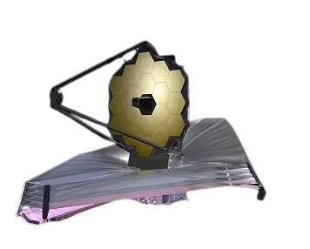
The James Webb Space Telescope (JWST)
Presented By:
Muhammad Kashif
Muhammad Mujeeb
Hassan Yousaf
Ahmed Rao
Rizwan Javaid

Slide 2
01
Introduction
02
Stakeholder Analysis
03
Key Challenges
Table Of Content
04
PM Methodologies
05
Successes & Failures
06
Global Lesson For PM
07
Emerging Trends
08
Conclusion

Slide 3
01
INTRODUCTION

Slide 4
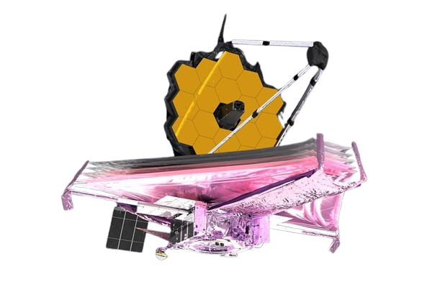
Introduction:
The James Webb Space Telescope (JWST) is a landmark aerospace megaproject developed over more than two decades. With a budget of nearly $10 billion and global collaboration, it stands as one of the most complex engineering and project management undertakings in history.
Led by NASA (National Aeronautics and Space Administration).
In partnership with ESA (European Space Agency) and CSA (Canadian Space Agency).
Designed to explore the early universe, star formation, and exoplanets.
Represents the next generation after the Hubble Space Telescope.
“JWST reflects how visionary goals require long-term commitment, collaboration, and disciplined project management.”

Slide 5
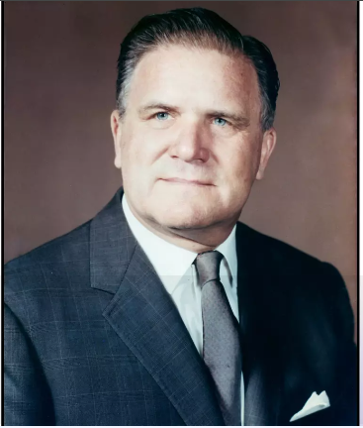
Project Background
The idea for JWST began in 1996 under the name “Next Generation Space Telescope.” Over time, changing scientific priorities and technological advancements shaped a more ambitious mission.
Concept evolved from a basic Hubble successor → to a foldable infrared observatory.
Renamed after NASA administrator James E. Webb in 2002.
Early technical feasibility was uncertain → required continuous prototyping and redesign.
“JWST is a benchmark for managing unprecedented, high-risk megaprojects.”

Slide 6
Timeline Overview
JWST’s timeline reflects how large-scale projects face delays due to technical complexity, integration challenges, and evolving requirements. Managing this timeline required strict re-baselining and external review processes.
(December 25, 2021)
Major delays due to:
03
Actual launch
Sunshield Redesign
(Added 2–3 years, for tears, deployment failures, and structural rework.)
Launch Vehicle Changes
(Added ~1 year, for required updates for Ariane 5 compatibility.)
Testing Failures & Safety Issues
(Added 1.5–2 years for vibration failures, hardware damage, and sunshield tears.)
02
(2007)
Planned Launch
(1996)
Project Start
01

Slide 7
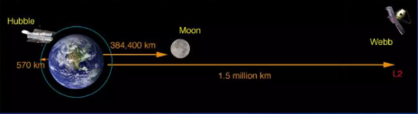
Project Scale & Complexity
The JWST incorporates some of the most advanced technologies ever used in space. These innovations significantly increased project complexity and risk, requiring rigorous project controls.
Huge Workforce
10,000+ people involved across 29+ years.
6.5m gold-coated segmented mirror.
Tennis-court-sized sunshield → 5 layers for thermal protection.
Required to operate at −233°C for infrared sensitivity.
First telescope capable of observing the first galaxies formed after the Big Bang.
Global Collaboration
Work distributed across 14 countries and hundreds of subcontractors.
Complex Integration
Over 100 major components required integration and synchronized testing.

Slide 8
02
STAKEHOLDER
ANALYSIS

Slide 9

Stakeholders in JWST Project:
The JWST project involved a complex network of stakeholders. These stakeholders included agencies responsible for funding, technical execution, international collaboration, and end-users of the telescope’s data. Managing their expectations and coordinating their activities was crucial for project success.
Primary stakeholders: NASA (National Aeronautics and Space Administration), ESA (European Space Agency), CSA (Canadian Space Agency)
Contractors: Northrop Grumman, Ball Aerospace, Lockheed Martin. (Responsible for integration, testing, and manufacturing)
End-users: Scientists, universities, and research institutions that define requirements
Oversight bodies: US Congress, funding agencies, international partners
“JWST success depended on balancing the needs and influence of a diverse, global stakeholder network.”

Slide 10
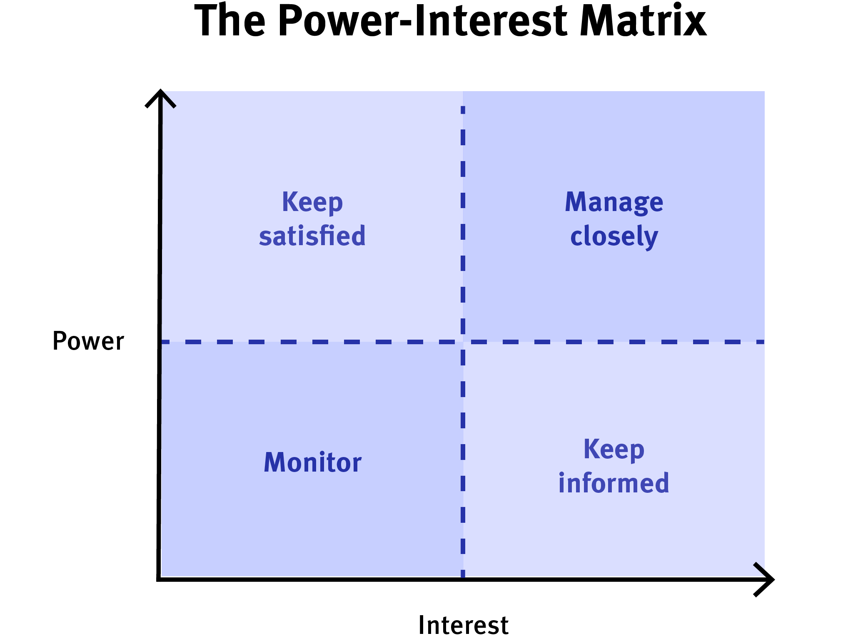
Stakeholder Map
A stakeholder map helps visualize each stakeholder’s level of influence and interest. For JWST, this map guided engagement and resource allocation, ensuring key players stayed aligned while indirect stakeholders were appropriately informed.
High
NASA,
ESA,
CSA,
US Congress
Other govt
or
funding agencies
Media
&
General Public
Scientists
&
universities
Low
High

Slide 11
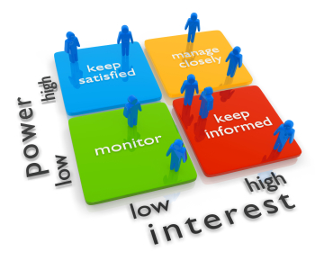
How Stakeholder Manages During Project
During JWST’s execution, stakeholder mapping was not just a planning exercise, it was a living tool used to manage communications, decision-making, and risk. The project team continuously monitored stakeholder influence and interest to ensure alignment across agencies, contractors, and scientific users.
Frequent technical and management reviews for high influence/high interest stakeholders (NASA, ESA, CSA)
Integration meetings and milestone reporting with contractors to coordinate complex deliveries
Requirement workshops and early testing feedback for scientific community
Formal briefings for oversight bodies and funding agencies to maintain transparency
Regular updates to the stakeholder map to reflect changing influence or interest over the 25-year timeline

Slide 12
03
KEY CHALLENGES

Slide 13
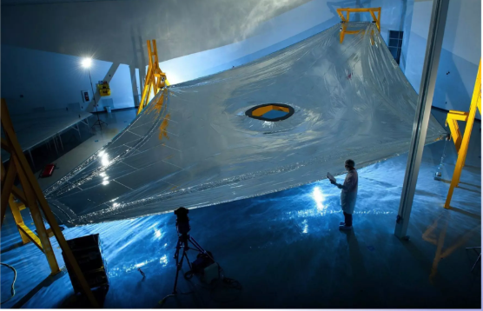
Key Challenges Of JWST:
JWST faced unprecedented challenges due to its technical complexity, long duration, high budget, and multi-agency collaboration. Understanding these challenges helps project managers learn how to mitigate risks and maintain control over megaprojects.
Extreme technical complexity (foldable mirrors,
sunshield, cryogenic systems)
Long timeline (25 years from concept to launch)
Multi-agency and multinational collaboration
Budget constraints and political scrutiny
“Managing high-risk, high-complexity projects requires proactive identification and mitigation of challenges.”

Slide 14
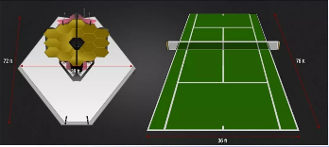
Technical Complexity:
JWST pushed the boundaries of engineering. Every subsystem had tight tolerances, zero-repair tolerance, and unprecedented requirements. This demanded meticulous planning, testing, and systems engineering.
6.5m segmented mirror, foldable, micron-level alignment
Sunshield deployment, 50-step process, size of a tennis court
Cryogenic operation, −233°C for infrared sensitivity
Single-point failures, 344 mechanisms critical for mission success
Required extensive simulations, prototypes, and integration testing

Slide 15
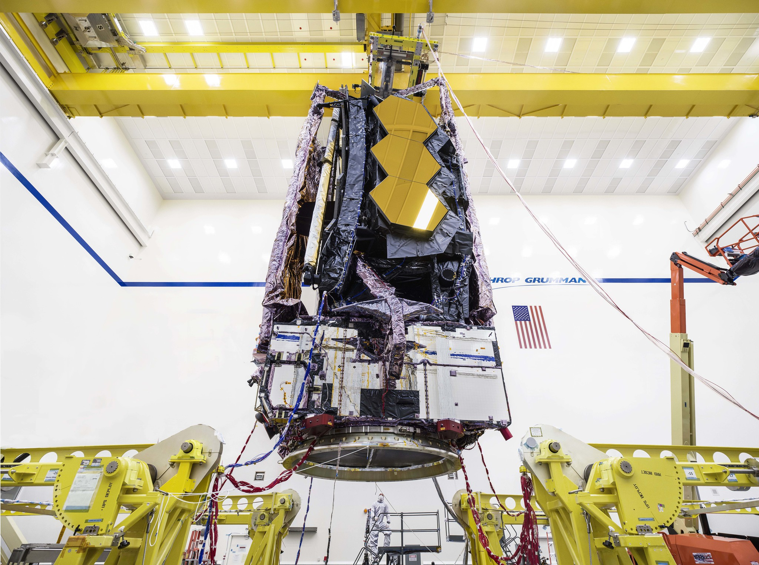
Schedule Challenges:
JWST’s long development cycle exposed it to multiple schedule risks. Delays occurred due to technical setbacks, integration issues, and evolving requirements. PM practices were essential to keep the project on track.
Original launch: 2007 → Actual launch: 2021
Major delays caused by:
Sunshield redesign and testing failures (+2–3 years)
Launch vehicle adjustments (+1 year)
Hardware damage during vibration tests (+1.5–2 years)

Slide 16
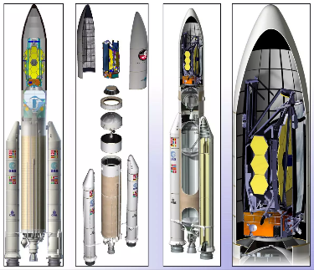
Scope Challenges:
JWST’s scope evolved over time as technology advanced and scientific requirements expanded. Managing scope creep was essential to balance ambition with feasibility.
Shift from simple Hubble successor → foldable infrared observatory
Added instruments and capabilities during development
Managed through:
Structured change control processes
Regular stakeholder reviews
Alignment of technical and scientific goals

Slide 17
Risk Management Complexity:
JWST faced technical, schedule, cost, and operational risks. A comprehensive risk management framework was critical to minimize the likelihood of catastrophic failures.
Technical risks: untested components, zero-repair tolerance
Schedule risks: long development, integration dependencies
Cost risks: inflation, redesigns, delayed milestones
Operational risks: deployment failures in space impossible to repair
Mitigation strategies:
Extensive simulations and testing
Redundancy in critical systems
Regular risk reviews and mitigation planning

Slide 18
04
PROJECT MANAGEMENT METHODOLOGIES FOR JWST

Slide 19
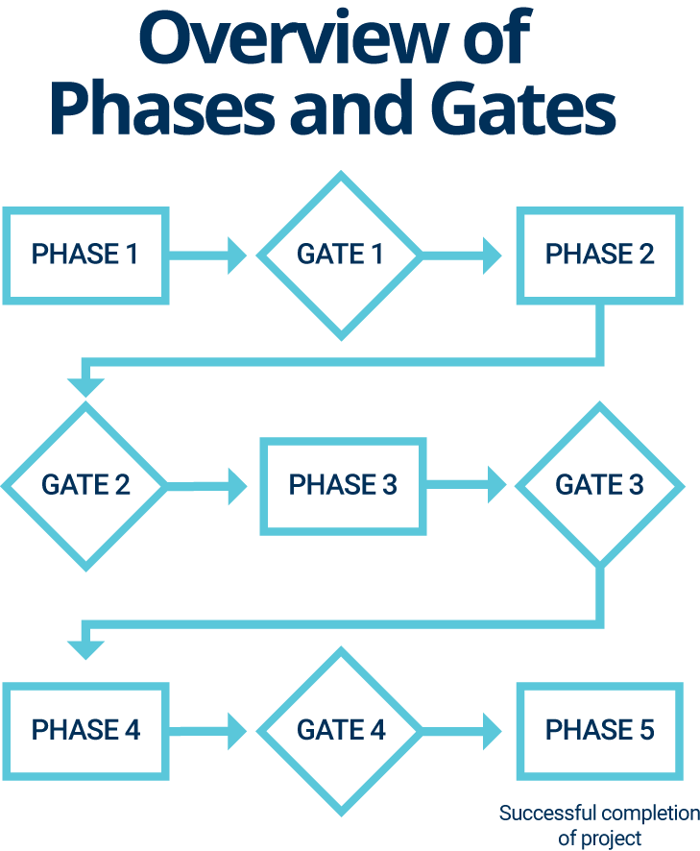
Systems Engineering & Phase-Gate Execution
JWST used systems engineering combined with milestone (phase-gate) management to ensure all subsystems worked together perfectly across its long, complex development.
Iterative prototyping and testing for mirrors, instruments, and sunshield before integration
Phase-gate approvals from NASA, ESA, CSA before advancing each development stage
Thermal, vibration, and deployment simulations to detect failures early
Feedback loops between subsystem teams to solve problems without delaying overall schedule

Slide 20
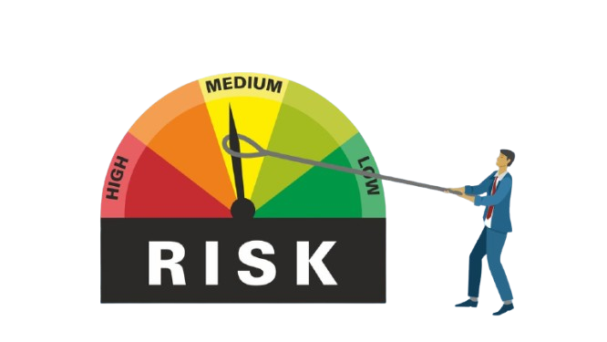
Risk Management
Risk management was continuously applied to prevent critical failures during development, testing, and launch.
Risk registers tracked technical, schedule, cost, and operational risks
Redundancy and prototypes for critical components (mirrors, sunshield, cryogenics)
Regular risk review meetings with agencies and contractors
Scope or design changes triggered reassessment and mitigation updates

Slide 21

Stakeholder Management & Governance
Managing multiple agencies, contractors, and scientific teams was essential to maintain alignment and accountability.
Clear roles, responsibilities, and decision authority for NASA, ESA, CSA, and contractors
Weekly and monthly progress reviews
Workshops and technical briefings to involve scientists in updates
Continuous monitoring of stakeholder influence and interest during redesigns and delays

Slide 22
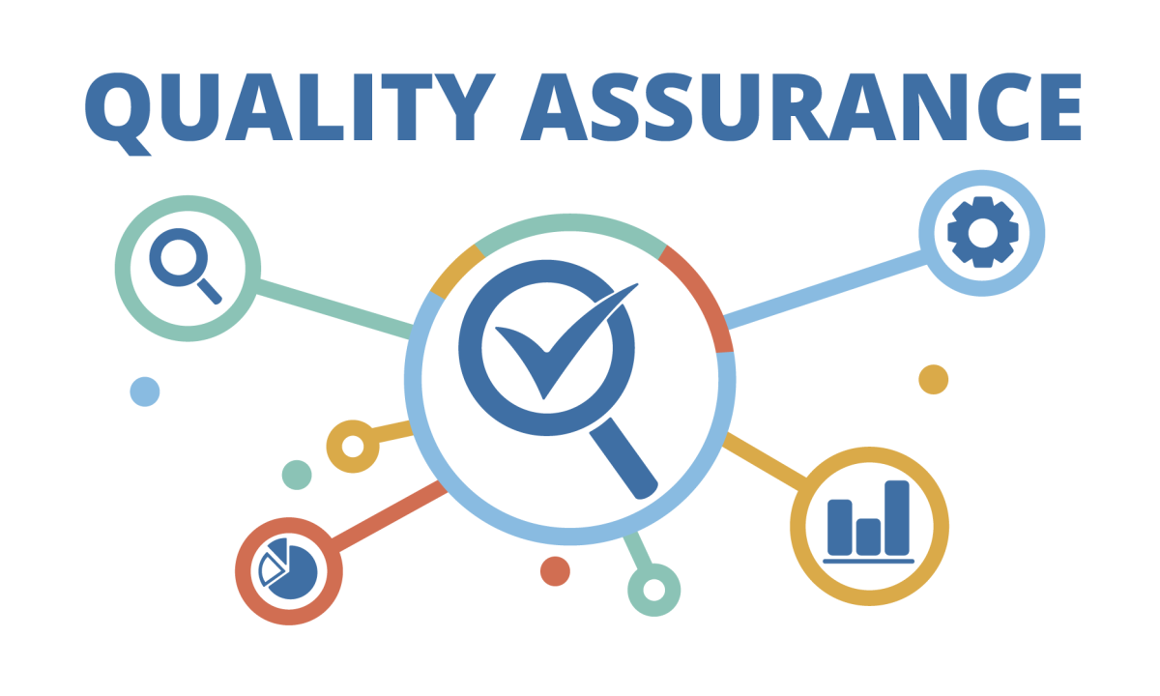
Integration & Quality Assurance Practices
JWST’s complexity required meticulous integration and quality assurance to ensure that all components functioned flawlessly together. These practices were essential to prevent failures in the final system.
Integrated testing of subsystems: Mirrors, sunshield, and instruments were tested together to verify full system performance
Environmental and deployment simulations: Thermal, vibration, and cryogenic tests mimicked space conditions
Cross-team coordination: Engineers from NASA, ESA, CSA, and contractors collaborated closely to resolve issues detected during integration
Documentation and traceability: Every test, modification, and issue was logged to maintain transparency and accountability

Slide 23
05
SUCCESSES & FAILURES

Slide 24

Major Successes Of JWST:
JWST’s successes were largely due to effective project management practices, which ensured coordination, risk mitigation, and disciplined execution across a highly complex, long-duration, and multi-agency project.
Structured milestone reviews and phase-gate approvals: Enabled timely, informed decisions at critical points
Effective multi-agency governance: Roles and responsibilities clearly defined between NASA, ESA, CSA, and contractors
Proactive risk management: High-risk components were tested iteratively to prevent failures
Stakeholder engagement: Transparent reporting maintained trust and alignment during long delays
Integration oversight: Coordinated testing of 100+ subsystems ensured alignment with overall objectives

Slide 25

Major Failures / Challenges Of JWST:
Despite strong PM practices, JWST faced several project management challenges related to scheduling, scope, coordination, and risk. These setbacks offered valuable lessons for managing complex projects.
Schedule management issues: Original 2007 launch postponed to 2021 due to underestimated integration complexity
Scope creep and redesigns: Sunshield and instrument modifications impacted schedule and costs
Communication gaps: Initial delays in integrating international contractor outputs caused rework
Risk contingency underestimation: Some technical risks (sunshield tears, vibration failures) required unplanned mitigation
Budget oversight challenges: Initial cost estimates proved unrealistic, requiring re-baselining

Slide 26
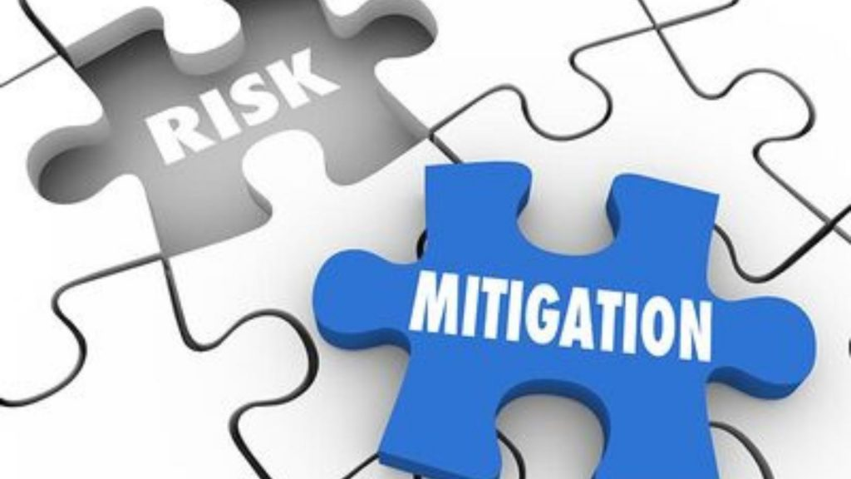
How JWST Mitigated Failures
Project managers applied targeted strategies to recover JWST from setbacks and maintain alignment with objectives.
Re-baselined schedules and budgets: Adjusted milestones to reflect realistic execution plans
Enhanced cross-team coordination: Improved communication and reporting among NASA, ESA, CSA, and contractors
Strengthened risk management: Identified high-impact risks and implemented contingency plans
Applied iterative problem-solving and testing: Repeated subsystem testing and redesign cycles resolved integration issues

Slide 27
06
GLOBAL LESSONS FOR PM FROM JWST

Slide 28

Managing Complexity Through Structure & Discipline
JWST proves that extreme technical and organizational complexity can only be handled through structured planning, modular execution, disciplined change control, and continuous integration.
Break complex projects into manageable subsystems with clear ownership
Use phased development with defined milestones and checkpoints
Apply strict configuration and change control to prevent uncontrolled scope
Test early, test often, and test in layers to avoid catastrophic failures
“Complexity becomes manageable when structure, discipline, and controlled execution guide the project.”

Slide 29

Collaboration & Stakeholder Alignment Drive Success
With NASA, ESA, CSA, hundreds of subcontractors, and thousands of engineers, JWST demonstrates that megaproject success depends on keeping diverse stakeholders aligned through transparent communication and shared governance.
Use stakeholder mapping to prioritize influence, interest, and communication needs
Build formal governance frameworks for multi-agency collaboration
Maintain transparency using real-time reporting and documented decisions
Manage expectations proactively to preserve political and financial support
“Large projects succeed when stakeholders move in the same direction with shared clarity.”

Slide 30

Adaptive Risk & Recovery Management Is Essential
JWST faced repeated failures, redesigns, budget overruns, and more than a decade of delays. What saved the project was strong risk governance, adaptive re-planning, and decisive recovery mechanisms.
Treat risk as a continuously evolving element of the project
Re-baseline schedules and budgets when reality changes
Build contingency buffers into planning and funding
Use iterative problem-solving and robust technical reviews
Accept failures early and correct them systematically
“Adaptability is the difference between project failure and eventual success.”

Slide 31
07
Emerging Trends Applied or Needed in JWST

Slide 32
Why Emerging Trends Matter
JWST was conceived in 1996, but built over 25 years — during a time when project management tools and technologies evolved rapidly. Some trends were successfully adopted, while others emerged too late and would have significantly improved performance if available earlier.
Long-duration projects must evolve with new PM practices
Modern methodologies reduce risk, improve alignment, and enhance transparency
JWST provides a case study of both applied and missing trends
“Future megaprojects must integrate emerging tools continuously, not only at project start.”

Slide 33
Trends That JWST Successfully Applied
Although JWST began in an older PM era, the team adopted several modern practices during re-planning phases, which contributed to successful execution.
1. Digital Modelling & Early Prototyping: Used physical and digital prototypes to validate mirror segments, sunshield behavior, and deployment mechanisms.
2. Rigorous Systems Engineering Integration: Systems engineering became the core coordination framework across international teams.
3. Independent Technical & Risk Review Boards: External review panels acted much like today’s independent quality governance structures.
4. Enhanced Testing Culture (Iterative Testing): Shift from “test at the end” to “test every component repeatedly” (modern trend in aerospace).

Slide 34
Trends We Suggest For JWST Like Projects
Many PM innovations matured after JWST had already started. Their absence contributed to early failures, delays, and cost escalations.
1. Digital Twins: A full digital twin of JWST would've reduced integration failures, sunshield deployment issues, and vibration-test damages.
2. Agile-Based Iteration for Hardware Projects: Earlier adoption of hybrid agile–waterfall models could have improved responsiveness to scientific requirement changes.
3. Advanced Collaboration & PM Software: Modern cloud-based PM tools (Jira, Confluence, DevOps dashboards, digital PMIS) would have improved documentation, communication, and alignment.
4. Predictive Analytics & AI-Based Risk Monitoring: Today’s AI models could have predicted high-probability failure points and testing conflicts.

Slide 35
08
Conclusion

Slide 36
Conclusion
The James Webb Space Telescope stands as one of the most ambitious and instructive megaprojects ever delivered. Across 25+ years, changing requirements, unprecedented engineering challenges, international coordination, and repeated setbacks pushed the limits of project management discipline. Yet the project ultimately succeeded because of structured governance, adaptive planning, strong stakeholder alignment, and a commitment to continuous testing and problem-solving.
JWST demonstrates how visionary, high-risk projects require long-term strategic commitment
Effective stakeholder coordination is essential for multi-agency global programs
Strong risk management and re-baselining can revive failing projects
Modern tools, systems engineering, and iterative testing were critical enablers
JWST provides a blueprint for managing future space and scientific megaprojects
“JWST proves that even the most complex, uncertain, and long-duration projects can succeed when guided by disciplined project management, collaboration, and adaptability.”

Slide 37

Thank You!

